Slide 1
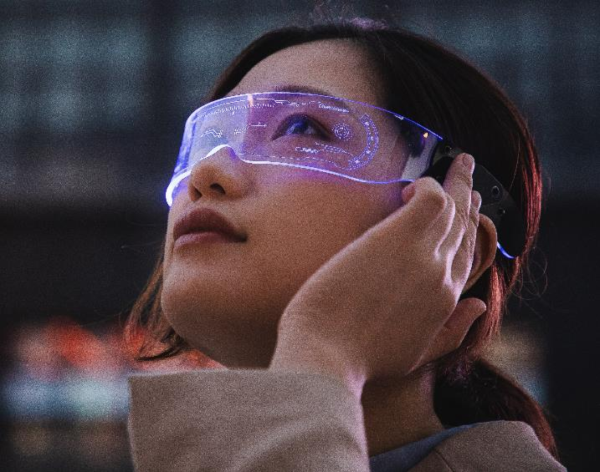
Gestures using Hand Movement in Laptops

Slide 2
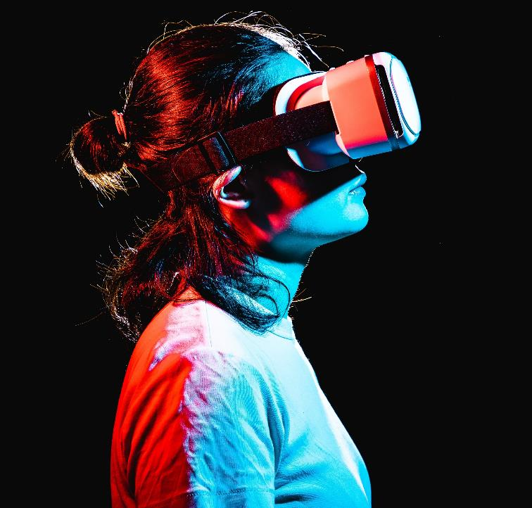
tEAM members (Group 15)
G Harshavardhan Tadikonda – CB.EN.U4CSE20621
Mukkanti Venkata Sai Karthik - CB.EN.U4CSE20639
Ravva Venkata Sai Likith – CB.EN.U4CSE20054
Chanamala Vipasyana Bhanu - CB.EN.U4CSE20114
Pokuri Sai Samhitha - CB.EN.U4CSE20048

Slide 3
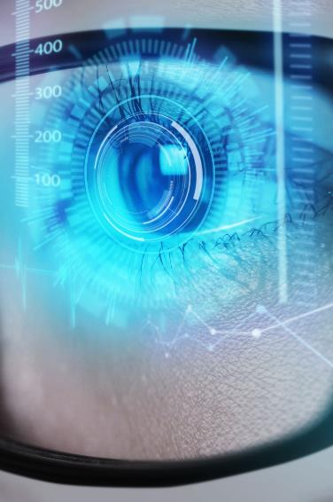
Hand Tracking module code
import cv2 import mediapipe as mp import time class HandDetector: def __init__(self, mode=False, max_hands=2, detection_confidence=0.5, track_confidence=0.5): self.mode = mode self.max_hands = max_hands self.detection_confidence = detection_confidence self.track_confidence = track_confidence self.mp_hands = mp.solutions.hands self.hands = self.mp_hands.Hands(self.mode, self.max_hands, self.detection_confidence, self.track_confidence) self.mp_draw = mp.solutions.drawing_utils

Slide 4
def find_hands(self, img, draw=True): img_rgb = cv2.cvtColor(img, cv2.COLOR_BGR2RGB) self.results = self.hands.process(img_rgb) if self.results.multi_hand_landmarks: for hand_landmarks in self.results.multi_hand_landmarks: if draw: self.mp_draw.draw_landmarks(img, hand_landmarks, self.mp_hands.HAND_CONNECTIONS) return img
def find_position(self, img, hand_number=0, draw=True): lm_list = [] if self.results.multi_hand_landmarks: hand_landmarks = self.results.multi_hand_landmarks[hand_number] for id, lm in enumerate(hand_landmarks.landmark): h, w, c = img.shape cx, cy = int(lm.x * w), int(lm.y * h) lm_list.append([id, cx, cy]) if draw: cv2.circle(img, (cx, cy), 5, (255, 0, 255), cv2.FILLED) return lm_list
def fingers_up(self): fingers = [] if self.results.multi_hand_landmarks: hand_landmarks = self.results.multi_hand_landmarks[0] # Thumb if hand_landmarks.landmark[self.mp_hands.HandLandmark.THUMB_MCP].x < hand_landmarks.landmark[ self.mp_hands.HandLandmark.THUMB_IP].x: fingers.append(1) else: fingers.append(0) # Other fingers for finger in [self.mp_hands.HandLandmark.INDEX_FINGER_MCP, self.mp_hands.HandLandmark.MIDDLE_FINGER_MCP, self.mp_hands.HandLandmark.RING_FINGER_MCP, self.mp_hands.HandLandmark.PINKY_MCP]: if hand_landmarks.landmark[finger].y < hand_landmarks.landmark[finger - 2].y: fingers.append(1) else: fingers.append(0) return fingers

Slide 5
def find_distance(self, p1, p2, img, draw=True): x1, y1 = self.landmark_positions[p1][1:] x2, y2 = self.landmark_positions[p2][1:] cx, cy = (x1 + x2) // 2, (y1 + y2) // 2 if draw: cv2.line(img, (x1, y1), (x2, y2), (255, 0, 255), 3) cv2.circle(img, (x1, y1), 8, (255, 0, 255), cv2.FILLED) cv2.circle(img, (x2, y2), 8, (255, 0, 255), cv2.FILLED) cv2.circle(img, (cx, cy), 8, (255, 0, 255), cv2.FILLED) length = int(((x2 - x1) ** 2 + (y2 - y1) ** 2) ** 0.5) return length
def main(): p_time = 0 c_time = 0 cap = cv2.VideoCapture(0) detector = HandDetector() while True: success, img = cap.read() img = detector.find_hands(img) lm_list = detector.find_position(img) if len(lm_list) != 0: print(lm_list[4]) c_time = time.time() fps = 1 / (c_time - p_time) p_time = c_time cv2.putText(img, f'FPS: {int(fps)}', (10, 70), cv2.FONT_HERSHEY_PLAIN, 3, (255, 0, 255), 3) cv2.imshow("Image", img) if cv2.waitKey(1) == ord('q'): break cap.release() cv2.destroyAllWindows() if __name__ == "__main__": main()

Slide 6
Hand Tracking module code (Brief Explanation)
Hand Tracking module code (Brief Explanation)
Initially we have imported the necessary libraries: cv2 for OpenCV, mediapipe for hand detection and tracking, and time for measuring frame rates.
The HandDetector class is defined, which encapsulates the functionality of hand detection and tracking. It is initialized with parameters such as mode, max_hands etc.
Within the HandDetector class, the find_hands method takes an image as input and performs hand detection on it. It returns the image with annotated hand landmarks if any hands are detected.
The find_position method extracts the positions of each hand landmark (such as fingers, palm, etc.) from the detected hands. It returns a list of landmark positions.
The fingers_up method determines the status (open or closed) of each finger based on the detected hand landmarks. It returns a list indicating whether each finger is up (1) or down (0).
The find_distance method calculates the Euclidean distance between two specified landmarks on the hand. It returns the distance value.
The main function is where the video capture, hand detection, and tracking take place. It initializes a HandDetector object and captures video from the default camera.
In each iteration of the main loop, it reads a frame from the camera, performs hand detection using the find_hands method, and retrieves the hand landmarks using the find_position method.
The code then prints the position of the fourth landmark (index finger tip) if it is detected.
The frame rate is calculated and displayed on the image using the cv2.putText function.
The annotated image is displayed in a window using cv2.imshow, and the loop continues until the user presses 'q' to quit.
Finally, the video capture is released, and all OpenCV windows are closed.
Initially we have imported the necessary libraries: cv2 for OpenCV, mediapipe for hand detection and tracking, and time for measuring frame rates.
The HandDetector class is defined, which encapsulates the functionality of hand detection and tracking. It is initialized with parameters such as mode, max_hands etc.
Within the HandDetector class, the find_hands method takes an image as input and performs hand detection on it. It returns the image with annotated hand landmarks if any hands are detected.
The find_position method extracts the positions of each hand landmark (such as fingers, palm, etc.) from the detected hands. It returns a list of landmark positions.
The fingers_up method determines the status (open or closed) of each finger based on the detected hand landmarks. It returns a list indicating whether each finger is up (1) or down (0).
The find_distance method calculates the Euclidean distance between two specified landmarks on the hand. It returns the distance value.
The main function is where the video capture, hand detection, and tracking take place. It initializes a HandDetector object and captures video from the default camera.
In each iteration of the main loop, it reads a frame from the camera, performs hand detection using the find_hands method, and retrieves the hand landmarks using the find_position method.
The code then prints the position of the fourth landmark (index finger tip) if it is detected.
The frame rate is calculated and displayed on the image using the cv2.putText function.
The annotated image is displayed in a window using cv2.imshow, and the loop continues until the user presses 'q' to quit.
Finally, the video capture is released, and all OpenCV windows are closed.

Slide 7
Gesture control code
import cv2 import mediapipe as mp from math import hypot import ctypes from ctypes import cast, POINTER from comtypes import CLSCTX_ALL from pycaw.pycaw import AudioUtilities, IAudioEndpointVolume import numpy as np import time import htm as ht import autopy
from google.protobuf.json_format import MessageToDict # building the model mpHands = mp.solutions.hands hands = mpHands.Hands( static_image_mode=False, min_detection_confidence=0.75, min_tracking_confidence=0.75, max_num_hands=2)

Slide 8
mpDraw = mp.solutions.drawing_utils devices = AudioUtilities.GetSpeakers() interface = devices.Activate(IAudioEndpointVolume._iid_, CLSCTX_ALL, None) volume = cast(interface, POINTER(IAudioEndpointVolume)) volMin, volMax = volume.GetVolumeRange()[:2] pTime = 0 width = 640 height = 480 frameR = 100 smoothening = 8 prev_x, prev_y = 0, 0 curr_x, curr_y = 0, 0
# reading from webcam webcam = cv2.VideoCapture(0) webcam.set(3, width) webcam.set(4, height) detector = ht.handDetector(maxHands=1) screen_width, screen_height = autopy.screen.size()
def minimize_maximize_window(): ctypes.windll.user32.keybd_event(0x5B, 0, 0, 0) # Left Windows Key Down ctypes.windll.user32.keybd_event(0x4D, 0, 0, 0) # 'M' Key Down ctypes.windll.user32.keybd_event(0x4D, 0, 2, 0) # 'M' Key Up ctypes.windll.user32.keybd_event(0x5B, 0, 2, 0) # Left Windows Key Up while True: success, img = webcam.read() # flipping the image for model original_img=img.copy() # copying the original image img = cv2.flip(img, 1) # converting to RGB for model (model needs RGB img) RGB_img = cv2.cvtColor(img, cv2.COLOR_BGR2RGB)
# passing the image to the model results = hands.process(RGB_img) # if there is any result (if any hand is detected) if results.multi_hand_landmarks: if len(results.multi_handedness) == 2: # if two hands exist in the image cv2.putText(original_img, 'Both Hands', (250, 56), cv2.FONT_HERSHEY_COMPLEX, 0.8, (0, 255, 0), 2)

Slide 9
else: # if only one hand exists in the image for i in results.multi_handedness: label = MessageToDict(i)['classification'][0]['label’]
if label == 'Left': cv2.putText(original_img, f'{label} Hand', (20, 56), cv2.FONT_HERSHEY_COMPLEX, 0.8, (0, 255, 0), 2) lmList = [] if results.multi_hand_landmarks: for handlandmark in results.multi_hand_landmarks: for id, lm in enumerate(handlandmark.landmark): h, w, c = img.shape cx, cy = int(lm.x * w), int(lm.y * h) lmList.append([id, cx, cy]) mpDraw.draw_landmarks(img, handlandmark, mpHands.HAND_CONNECTIONS) x1, y1 = lmList[4][1], lmList[4][2] x2, y2 = lmList[8][1], lmList[8][2] cv2.circle(img, (x1, y1), 15, (255, 0, 0), cv2.FILLED) cv2.circle(img, (x2, y2), 15, (255, 0, 0), cv2.FILLED) cv2.line(img, (x1, y1), (x2, y2), (255, 0, 0), 3) length = hypot(x2 - x1, y2 - y1) vol = np.interp(length, [15, 220], [volMin, volMax]) print(vol, length)
volume.SetMasterVolumeLevel(vol, None)
if label == 'Right': img = original_img.copy() cv2.putText(original_img, f'{label} Hand', (460, 56), cv2.FONT_HERSHEY_COMPLEX, 0.8, (0, 255, 0), 2) img = detector.findHands(img) lmlist, bbox = detector.findPosition(img) if len(lmlist) != 0: x1, y1 = lmlist[8][1:] x2, y2 = lmlist[12][1:] fingers = detector.fingersUp() cv2.rectangle(img, (frameR, frameR), (width - frameR, height - frameR), (255, 0, 255), 2) if fingers[1] == 1 and fingers[2] == 0: x3 = np.interp(x1, (frameR, width - frameR), (0, screen_width)) y3 = np.interp(y1, (frameR, height - frameR), (0, screen_height)) curr_x = prev_x + (x3 - prev_x) / smoothening curr_y = prev_y + (y3 - prev_y) / smoothening
autopy.mouse.move(screen_width - curr_x, curr_y) cv2.circle(img, (x1, y1), 7, (255, 0, 255), cv2.FILLED) prev_x, prev_y = curr_x, curr_y
if fingers[1] == 1 and fingers[2] == 1: length, img, lineInfo = detector.findDistance(8, 12, img)

Slide 10
if length < 30: cv2.circle(img, (lineInfo[4], lineInfo[5]), 15, (0, 255, 0), cv2.FILLED) autopy.mouse.click() if all(fingers): minimize_maximize_window()
cTime = time.time() fps = 1 / (cTime - pTime) pTime = cTime cv2.putText(img, str(int(fps)), (20, 50), cv2.FONT_HERSHEY_PLAIN, 3, (255, 0, 0), 3) cv2.imshow('image', img) if cv2.waitKey(1) & 0xff == ord('q'): break webcam.release() cv2.destroyAllWindows()

Slide 11
Gesture control code (Brief Explanation)
Initially we have imported the necessary libraries and modules required for the code, including OpenCV (cv2), MediaPipe (mediapipe), math (math), ctypes, comtypes, pycaw, numpy (np), time, htm, and autopy.
Next we have initialized the hand detection model from MediaPipe (mpHands.Hands) with specific parameters such as static_image_mode, min_detection_confidence, min_tracking_confidence, and max_num_hands.
Next we are retrieving the audio devices (speakers) using AudioUtilities and activates the audio endpoint volume interface.
Next we have initialized various variables, including pTime (previous time), width, height, frameR (frame range), smoothening (smoothing factor), prev_x, prev_y, curr_x, and curr_y.
Next the code sets up the webcam input (cv2.VideoCapture(0)) and sets the width and height of the webcam stream.
Inside the main loop, the code reads frames from the webcam and performs the following steps:
Flips the image horizontally using cv2.flip.
Converts the image to RGB format for input to the hand detection model using cv2.cvtColor.
Passes the RGB image to the hand detection model and retrieves the results (results).
Checks if any hands are detected (if results.multi_hand_landmarks).
If hands are detected, it processes the hand landmarks based on the label of the hand (left or right).

Slide 12
For the left hand:
Retrieves the hand landmarks and calculates the distance between specific points.
Interpolates the distance value to the volume range and sets the system volume accordingly.
For the right hand:
Uses a custom hand detection module (detector) to detect the hand and find hand landmarks.
Tracks the position of the index and middle fingers and performs mouse movement and click operations using the autopy library.
Calculates and displays the frames per second (FPS) on the image.
Displays the image with the overlays using cv2.imshow.
Breaks the loop if 'q' is pressed.
Releases the Webcam and Closes Windows: After the loop ends, the code releases the webcam resource using webcam.release() and closes the windows using cv2.destroyAllWindows().

Slide 13
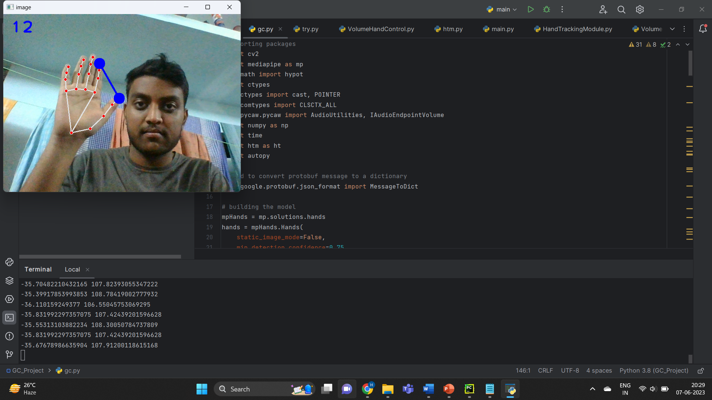
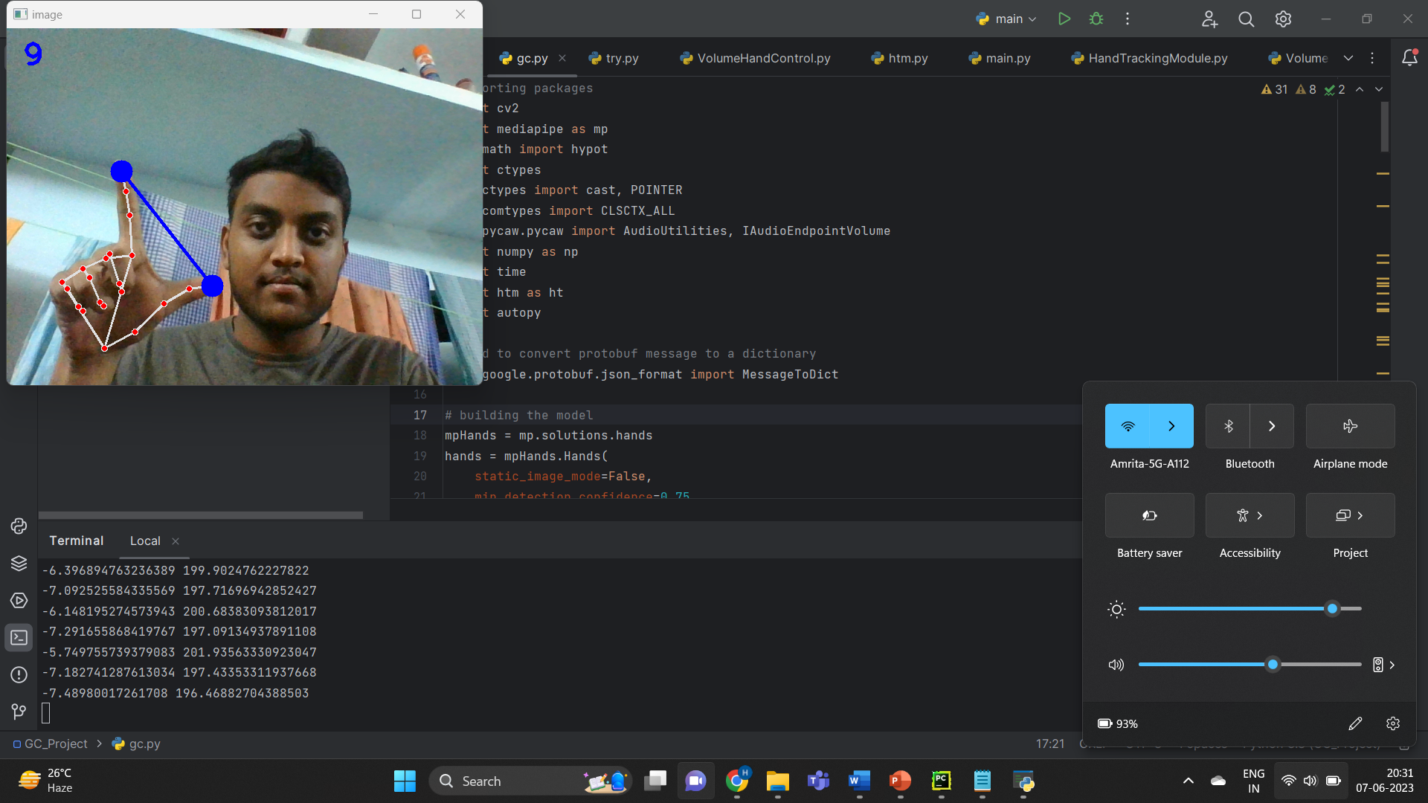
Analysis (Output snaps)
Detecting left hand
Controlling System Volume

Slide 14
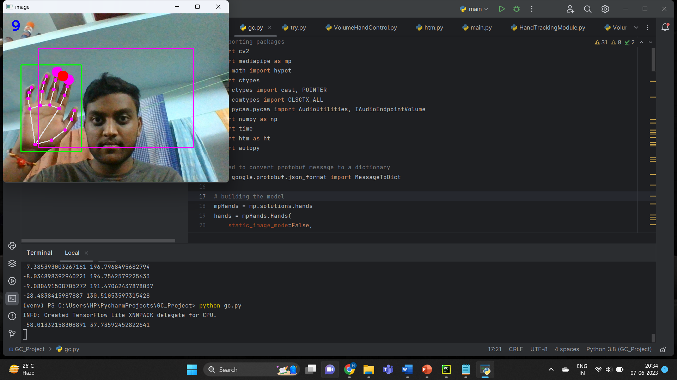
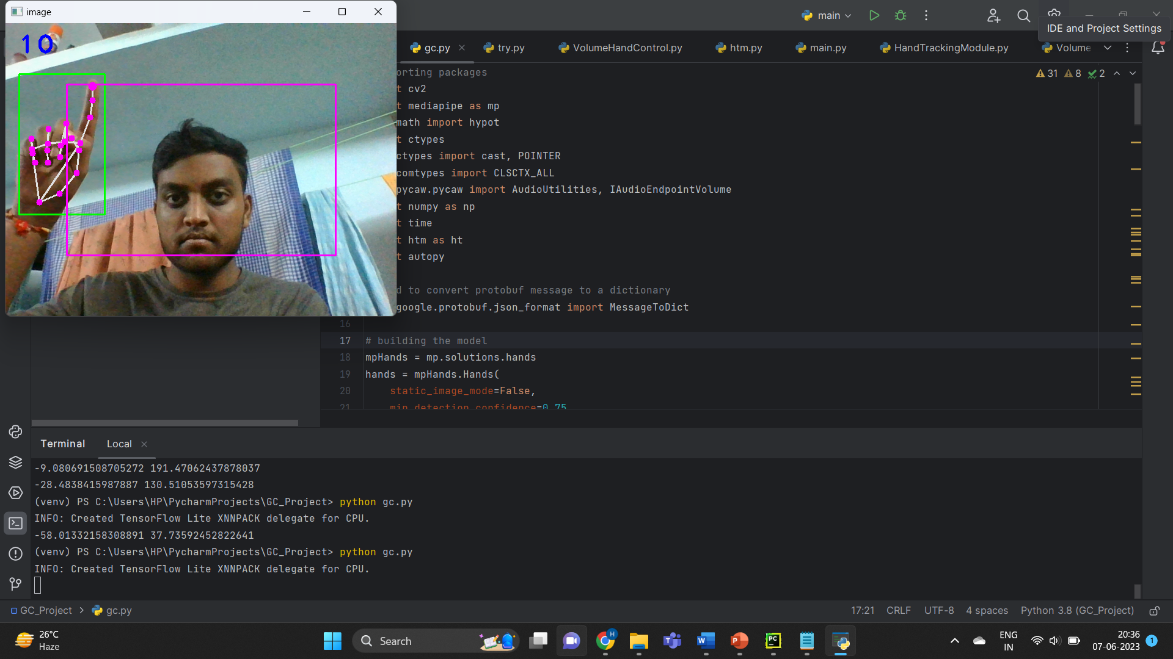
Detecting Right hand
Controlling Mouse Pointer

Slide 15
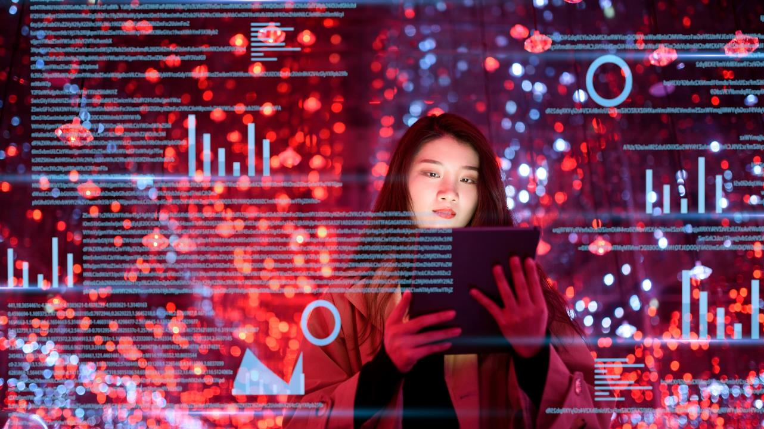
Summary
The "Hand Gesture Control for Volume and Mouse Pointer" project utilizes OpenCV, MediaPipe, and Python to enable control of the system volume and mouse pointer using hand gestures. The project leverages computer vision techniques to detect and track hand landmarks in real-time webcam video feed.
The application is divided into two main functionalities: volume control with the left hand and mouse pointer control with the right hand. The left hand is used to control the system volume by measuring the distance between thumb and index finger. The detected distance is then mapped to the volume range and adjusted accordingly using the pycaw library.
On the other hand, the right hand is used to control the mouse pointer. The hand is detected using a custom hand detection module, which utilizes the MediaPipe library. The module tracks the position of the index and middle fingers and performs mouse movement and click operations using the autopy library.
The system also provides visual feedback by overlaying the detected hand landmarks and other relevant information on the webcam video feed. The FPS (frames per second) is displayed on the screen to indicate the performance.
The project demonstrates the potential of using hand gestures as a natural and intuitive input method for controlling various aspects of a system. It combines computer vision, machine learning, and system interaction techniques to create a user-friendly and interactive experience.

Slide 16
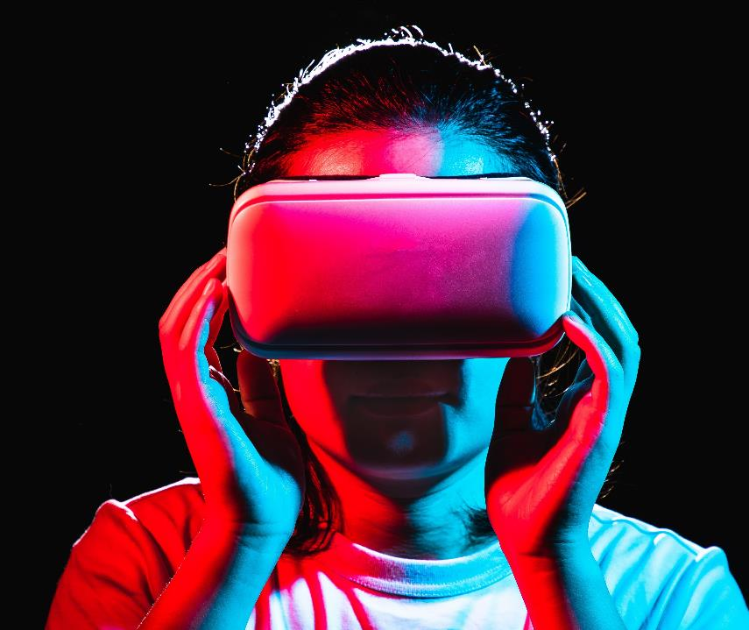
Thank you

